Slide 1


PYTHON
Lecture 28

Slide 2

Today’s Agenda
List -IV
Methods Of List

Slide 3
List Methods
There are some methods also in Python that we can use on lists.
These are:
append()
extend()
insert()
index()
count()
remove()
pop()
clear()
sort()
reverse()

Slide 4

The append( ) Method
Adds a single element to the end of the list . Modifies the list in place but doesn’t return anything
Syntax:
list_var.append(item)
Example:
primes=[2,3,5,7]
primes.append(11)
print(primes)
Output:

Slide 5
Guess The Output ?
animal = ['cat', 'dog', 'rabbit']
wild_animal = ['tiger', 'fox']
animal.append(wild_animal)
print(animal)
Output:
It's important to notice that, append() adds entire list as a single element .
If we need to add items of a list to the another list (rather than the list itself), then we must use the extend() method .

Slide 6
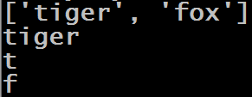
Guess The Output ?
animal = ['cat', 'dog', 'rabbit']
wild_animal = ['tiger', 'fox']
animal.append(wild_animal)
print(animal[3])
print(animal[3][0])
print(animal[3][0][0])
print(animal[3][1][0])
Output:

Slide 7
Exercise
Write a program to accept an alphanumeric string from the user. Now extract only digits from the given input and add it to the list . Finally print the list. Make sure your list contains numeric representation of digits
Output:

Slide 8
Solution
text=input("Enter an alphanumeric string:")
nums=[]
for x in text:
if x in "0123456789":
nums.append(int(x))
print(nums)

Slide 9
The extend( ) Method
extend() also adds to the end of a list, but the argument is expected to be an iterable.
The items in <iterable> are added individually.
Modifies the list in place but doesn’t return anything
Syntax:
list_var.extend(iterable)
Example:
primes=[2,3,5,7]
primes.extend([11,13,17])
print(primes)
Output:

Slide 10
Guess The Output ?
primes=[2,3,5,7]
primes.extend(11)
print(primes)
Output:

Slide 11

Guess The Output ?
primes=[2,3,5,7]
primes.extend([11])
print(primes)
Output:

Slide 12
Guess The Output ?
animal = ['cat', 'dog', 'rabbit']
wild_animal = ['tiger', 'fox']
animal.extend(wild_animal)
print(animal)
Output:

Slide 13

Guess The Output ?
animal = ['cat', 'dog', 'rabbit']
wild_animal = ['tiger', 'fox']
animal.extend(wild_animal)
print(animal[3])
print(animal[3][0])
print(animal[3][1])
Output:

Slide 14
Guess The Output ?
colors=["red","green"]
colors.extend("blue")
print(colors)
Output:

Slide 15
Guess The Output ?
colors=["red","green"]
colors.extend(["blue"])
print(colors)
Output:

Slide 16

Guess The Output ?
a = [1, 2, 3]
b = [4, 5, 6].extend(a)
print(b)
Output:

Slide 17

The insert( ) Method
The insert() method inserts the element to the list at the given index.
Modifies the list in place but doesn’t return anything
Syntax:
list_var.insert(index,item)
Example:
primes=[2,3,7,9]
primes.insert(2,5)
print(primes)
Output:

Slide 18

Guess The Output ?
primes=[2,3,7,9]
primes.insert(-2,5)
print(primes)
Output:

Slide 19
Guess The Output ?
primes=[2,3,5,7]
primes.insert(5,9)
print(primes)
Output:
The method insert( ) works like slicing operator . So even if the index given is beyond range , it will add the element at the end.

Slide 20

Guess The Output ?
primes=[2,3,5,7]
primes.insert(-5,9)
print(primes)
Output:

Slide 21
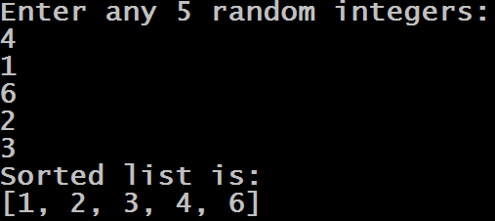
Exercise
Write a program to accept any 5 random integers from the user and add them in a list in such a way that list always remains sorted. DO NOT USE THE FUNCTION sort( )
Output:

Slide 22
Solution
i=1
sortednums=[]
print("Enter any 5 random integers:")
while i<=5:
n=int(input())
pos=0
for x in sortednums:
if x>n:
break
pos=pos+1
sortednums.insert(pos,n)
i=i+1
print("Sorted list is:")
print(sortednums)

Slide 23
The index( ) Method
The index() method searches an element in the list and returns it’s index.
If the element occurs more than once it returns it’s smallest/first position.
If element is not found, it raises a ValueError exception
Syntax:
list_var.index(item)
Example:
primes=[2,3,5,7]
pos=primes.index(5)
print("position of 5 is",pos)
Output:

Slide 24

Guess The Output ?
vowels = ['a', 'e', 'i', 'o', 'i', 'u']
pos = vowels.index('e')
print('The index of e:',pos)
pos = vowels.index('i')
print('The index of i:',pos)
Output:

Slide 25
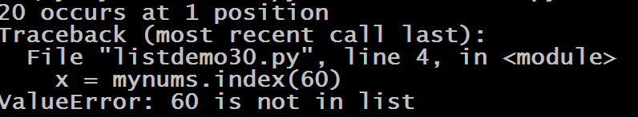
Guess The Output ?
mynums = [10,20,30,40,50]
x = mynums.index(20)
print("20 occurs at",x,"position")
x = mynums.index(60)
print("60 occurs at",x,"position")
x = mynums.index(10)
print("10 occurs at",x,"position")
Output:

Slide 26
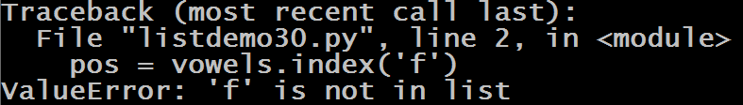
Guess The Output ?
vowels = ['a', 'e', 'i', 'o', 'i', 'u']
pos = vowels.index('f')
print('The index of e:',pos)
pos = vowels.index('i')
print('The index of i:',pos)
Output:

Slide 27
The count( ) Method
The count() method returns the number of occurrences of an element in a list
In simple terms, it counts how many times an element has occurred in a list and returns it.
Syntax:
list_var.count(item)
Example:
country=['i','n','d','i','a']
x=country.count('i')
print("i occurs",x,"times in",country)
Output:

Slide 28

Guess The Output ?
vowels = ['a', 'e', 'i', 'o', 'i', 'u']
x = vowels.count('i')
print("i occurs",x,"times")
x = vowels.count('e')
print("e occurs",x,"times")
x = vowels.count('j')
print("j occurs",x,"times")
Output:

Slide 29
Guess The Output ?
points = [1, 4, 2, 9, 7, 8, 9, 3, 1]
x = points.count(9)
print("9 occurs",x,"times")
Output:

Slide 30

Guess The Output ?
strings = ['Cat', 'Bat', 'Sat', 'Cat', 'cat', 'Mat']
x=strings.count("Cat")
print("Cat occurs",x,"times")
Output:

Slide 31
The remove( ) Method
The remove() method searches for the given element in the list and removes the first matching element.
If the element(argument) passed to the remove() method doesn't exist, ValueError exception is thrown.
Syntax:
list_var.remove(item)
Example:
vowels=['a','e','i','o','u']
vowels.remove('a')
print(vowels)
Output:

Slide 32

Guess The Output ?
subjects=["phy","chem","maths"]
subjects.remove("chem")
print(subjects)
Output:

Slide 33
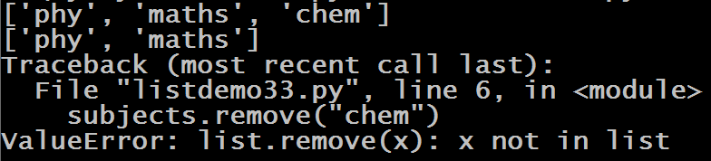
Guess The Output ?
subjects=["phy","chem","maths","chem"]
subjects.remove("chem")
print(subjects)
subjects.remove("chem")
print(subjects)
subjects.remove("chem")
print(subjects)
Output:

Slide 34
The pop( ) Method
The pop() method removes and returns the element at the given index (passed as an argument) from the list.
Syntax:
list_var.pop(index)
Important points about pop( ) method:
If the index passed to the pop() method is not in the range, it throws IndexError: pop index out of range exception.
The parameter passed to the pop() method is optional. If no parameter is passed, the default index -1 is passed as an argument which returns the last element
The pop() method returns the element present at the given index.
Also, the pop() method updates the list after removing the element

Slide 35

Guess The Output ?
fruits = ['apple', 'banana', 'cherry']
print(fruits)
print(fruits.pop(1))
print(fruits)
Output:

Slide 36

Guess The Output ?
fruits = ['apple', 'banana', 'cherry']
print(fruits)
print(fruits.pop())
print(fruits)
Output:

Slide 37
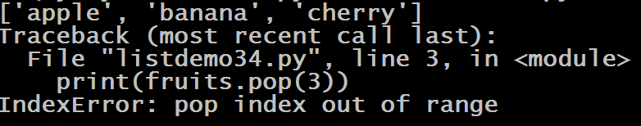
Guess The Output ?
fruits = ['apple', 'banana', 'cherry']
print(fruits)
print(fruits.pop(3))
print(fruits)
Output:

Slide 38

Guess The Output ?
fruits = ['apple', 'banana', 'cherry']
print(fruits)
print(fruits.pop(-3))
print(fruits)
Output:

Slide 39
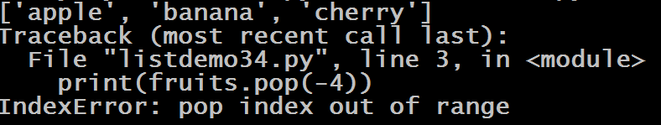
Guess The Output ?
fruits = ['apple', 'banana', 'cherry']
print(fruits)
print(fruits.pop(-4))
print(fruits)
Output:

Slide 40
del v/s pop( ) v/s remove( )
pop( ) : Takes Index , removes element & returns it
remove( ) : Takes value, removes first occurrence and returns nothing
delete : Takes index, removes value at that index and returns nothing
Even their exceptions are also different if index is wrong or element is not present:
pop() : throws IndexError: pop index out of range
remove(): throws ValueError: list.remove(x): x not in list
del: throws IndexError: list assignment index out of range

Slide 41

The clear( ) Method
The clear() method removes all items from the list.
It only empties the given list and doesn't return any value.
Syntax:
list_var.clear( )
Example:
fruits = ['apple', 'banana', 'cherry']
print(fruits)
fruits.clear()
print(fruits)
Output:

Slide 42
The sort( ) Method
The sort() method sorts the elements of a given list.
The order can be ascending or descending
Syntax:
list_var.sort(reverse=True|False, key=name of func)
Parameter Values:
Parameter Name | Description
reverse | Optional. reverse=True will sort the list descending. Default is reverse=False
key | Optional. A function to specify the sorting criteria(s)

Slide 43
Guess The Output ?
vowels = ['e', 'a', 'u', 'o', 'i']
vowels.sort()
print(vowels)
Output:

Slide 44
Guess The Output ?
vowels = ['e', 'a', 'u', 'o', 'i']
vowels.sort(reverse=True)
print(vowels)
Output:

Slide 45
Guess The Output ?
a = ["bee", "wasp", "moth", "ant"]
a.sort()
print(a)
Output:

Slide 46
Guess The Output ?
a = ["bee", "wasp", "moth", "ant"]
a.sort(reverse=True)
print(a)
Output:

Slide 47
Guess The Output ?
a = ["bee", "wasp", "moth", "ant"]
a.sort(key=len)
print(a)
Output:

Slide 48
Guess The Output ?
a = ["january", "february", "march"]
a.sort(key=len,reverse=True)
print(a)
Output:

Slide 49
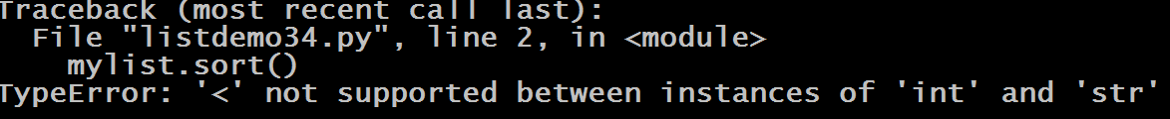
Guess The Output ?
mylist = ["a",10,True]
mylist.sort()
print(mylist)
Output:

Slide 50

Guess The Output ?
mylist = [25,10,True,False]
mylist.sort()
print(mylist)
Output:

Slide 51
Passing Our Own Function As Key
We also can pass our own function name to be used as key but it should take only 1 argument and return some value based on that argument.
This return value will be used by Python as key to sorting

Slide 52
Guess The Output ?
def sortSecond(val):
return val[1]
list1 = [(1,2),(3,3),(1,1)]
list1.sort(key=sortSecond)
print(list1)
Output:

Slide 53
Guess The Output ?
def sortSecond(val):
return 0
list1 = [(1,2),(3,3),(1,1)]
list1.sort(key=sortSecond)
print(list1)
Output:

Slide 54
Guess The Output ?
student_rec = [['john', 'A', 12],['jane', 'B', 7],['dave', 'B', 10]]
student_rec.sort()
print(student_rec)
Output:

Slide 55
Guess The Output ?
def myFunc(val):
return val[2]
student_rec = [['john', 'A', 12],['jane', 'B', 7],['dave', 'B', 10]]
student_rec.sort(key=myFunc)
print(student_rec)
Output:

Slide 56
The reverse( ) Method
The reverse() method reverses the elements of a given list.
It doesn't return any value. It only reverses the elements and updates the list.
Syntax:
list_var.reverse( )
Example:
os = ['Windows', 'macOS', 'Linux']
print('Original List:', os)
os.reverse()
print('Updated List:', os)
Output:

